Slide 1


Photocatalytic and Electrocatalytic Reduction of CO₂ to CO by
Polypyridyl Complexes
Isfahan University of Technology Department of Chemistry
August 2014
H. Hadadzadeh
Professor of Inorganic Chemistry

Slide 2

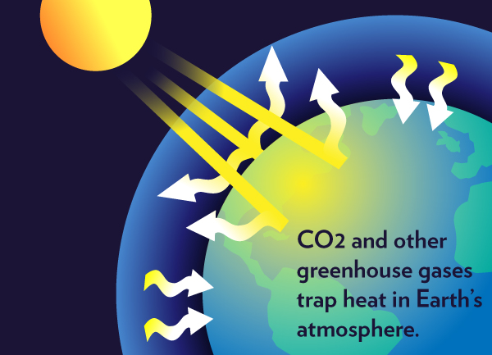
The greenhouse effect

Slide 3
CO₂ emissions by region and fuel

Slide 4
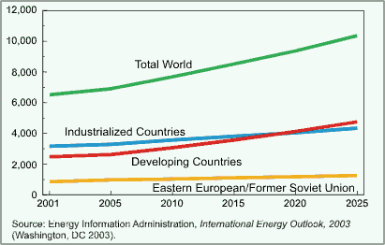
World CO₂ emissions by region, 2001-2025 (Million Metric Tons of Carbon Equivalent):

Slide 5
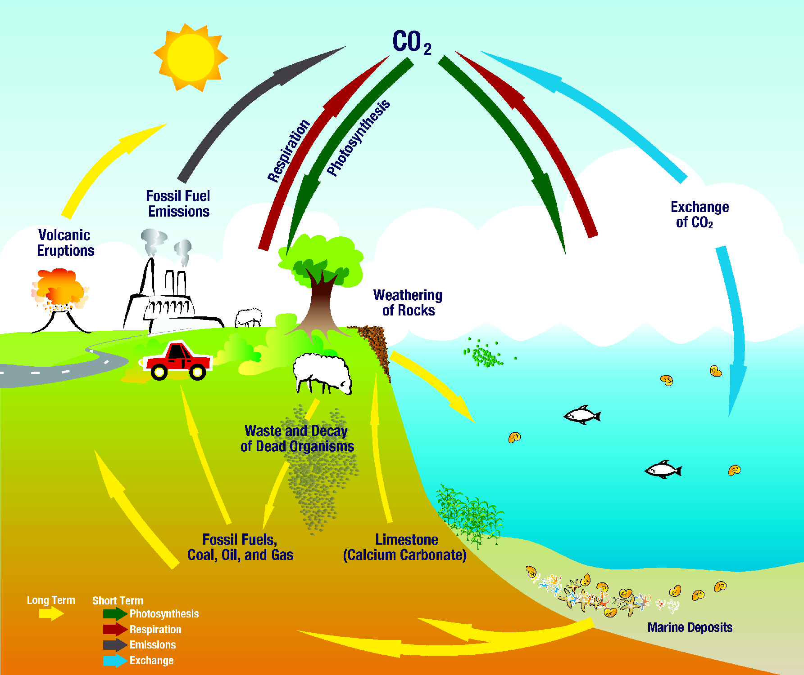
Earth's carbon cycle

Slide 6
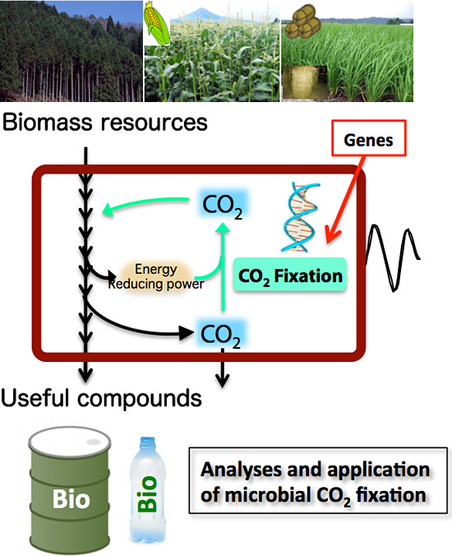
CO₂ fixation

Slide 7
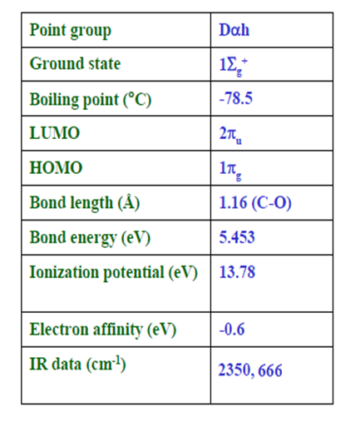
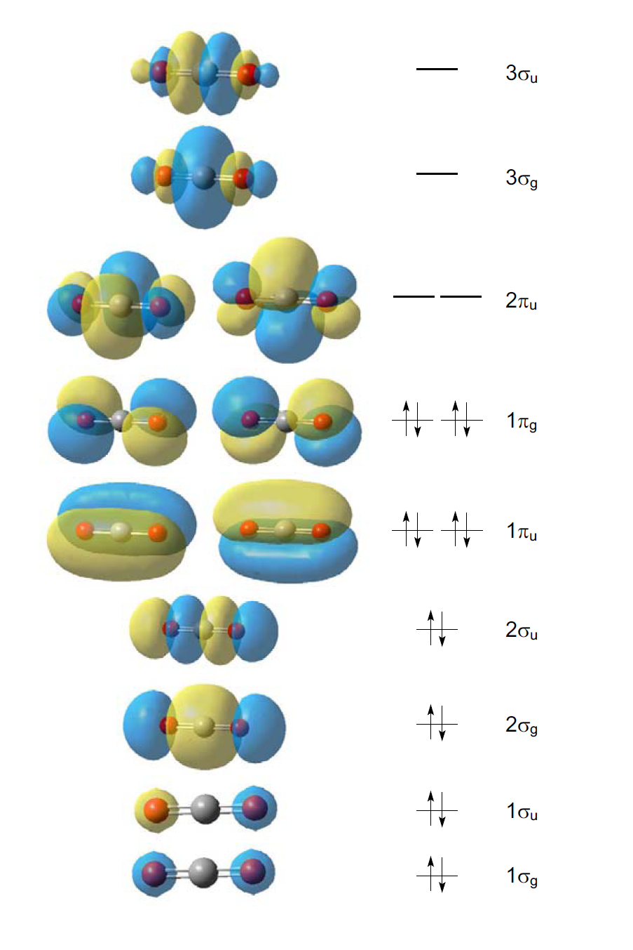
Selected properties and MO diagram for CO₂
Selected properties of CO₂
MO diagram of CO₂

Slide 8
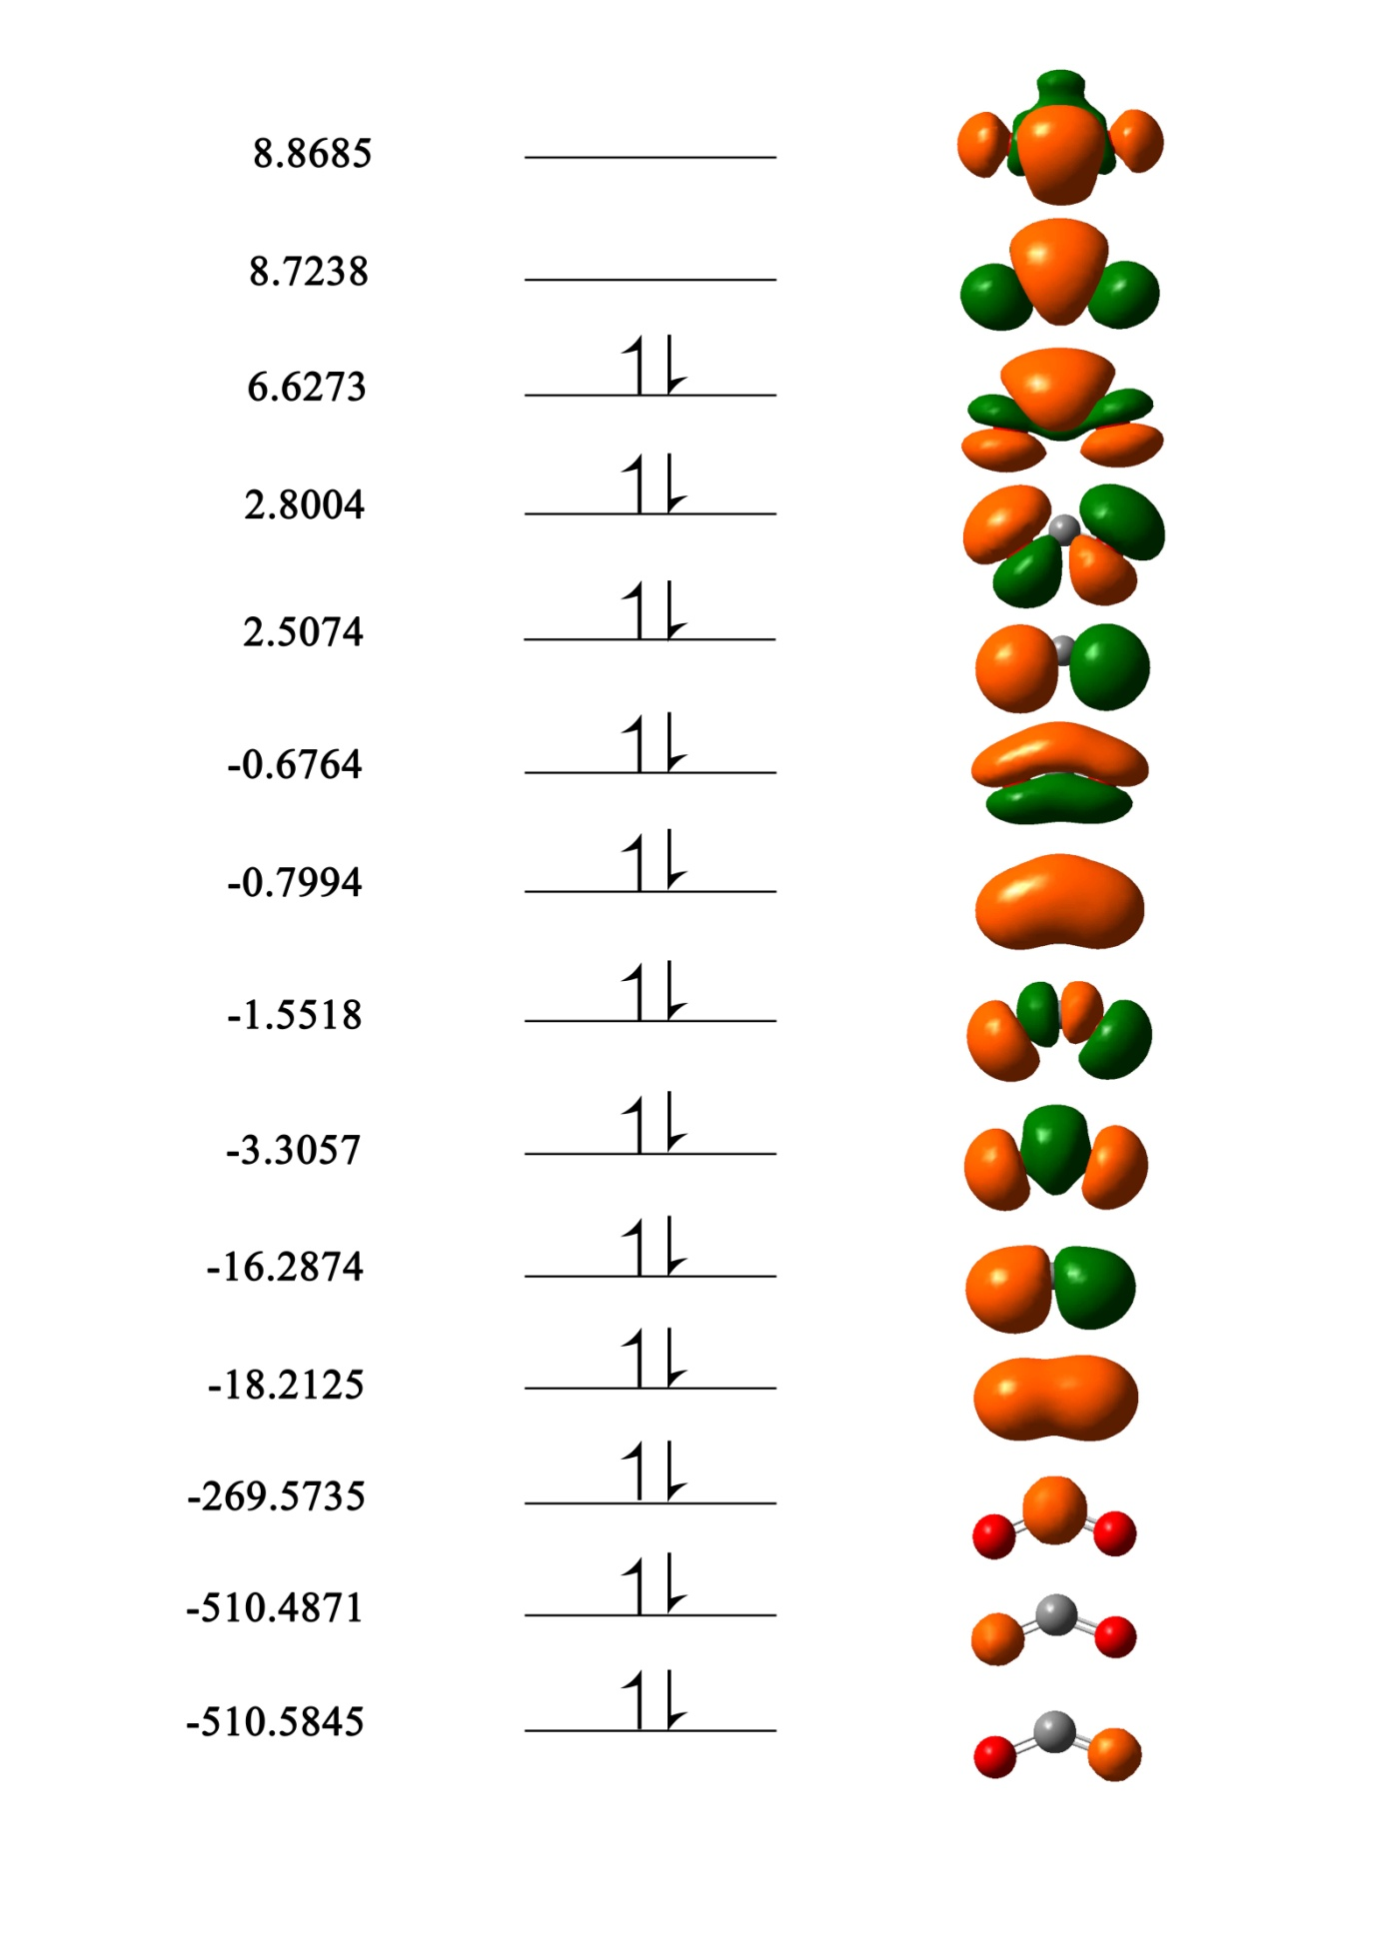
Schematic representation of the calculated molecular-orbitals in CO₂^{2–} (bent geometry) with their energy levels (eV):
CO: ΔH_{f}° = -110.52 kJ/mol, ΔG_{f}° = -137.27 kJ/mol
CO₂: ΔH_{f}° = -393.51 kJ/mol, ΔG_{f}° = -394.38 kJ/mol
CO + ½ O₂ → CO₂ heat = 282.99 kJ/mol

Slide 9
Attempts at CO₂ reduction
Radiochemical CO₂ HCOOH, HCHO
γ-radiation
Chemical reduction 2Mg + CO₂ → 2MgO + C
Thermochemical CO₂ CO + ½O₂
Ce⁴⁺
T>900°C
Photochemical CO₂ → CO, HCHO, HCOOH
hν
Electrochemical
CO₂ + xē + xH⁺ → CO, HCOOH, (COOH)₂
Biochemical CO₂ + 4H₂ CH₄ + 2H₂O
bacteria
Biophotochemical CO₂ + oxoglutaric acid → isocitric acid
hν
Photoelectrochemical CO₂ + 2ē + 2H⁺ CO + H₂O
hν
Bioelectrochemical CO₂ + oxoglutaric acid isocitric acid
enzyme
methylviologen
Biophotoelectrochemical CO₂ HCOOH
hν, enzyme
methylviologen
M. A. Scibioh, B. Viswanathan, Proc. Indn. Natl. Acad. Sci., 2004, 70 A, 65.

Slide 10

Electrochemical reduction of CO₂:
CO₂ + 2H⁺ + 2ē → CO + H₂O E°′ = -0.52 V
CO₂ + 2H⁺ + 2ē → HCOOH E°′ = -0.61 V
CO₂ + 4H⁺ + 4ē → HCHO + H₂O E°′ = -0.48 V
CO₂ + 6H⁺ + 6ē → CH₃OH + H₂O E°′ = -0.38 V
CO₂ + 8H⁺ + 8ē → CH₄ + 2H₂O E°′ = -0.24 V
Canseco-Gonzalez, M., Dalton Trans., 2013, 42, 7424.
M. A. Scibioh, B. Viswanathan, Proc. Indn. Natl. Acad. Sci., 2004, 70 A, 65.

Slide 11
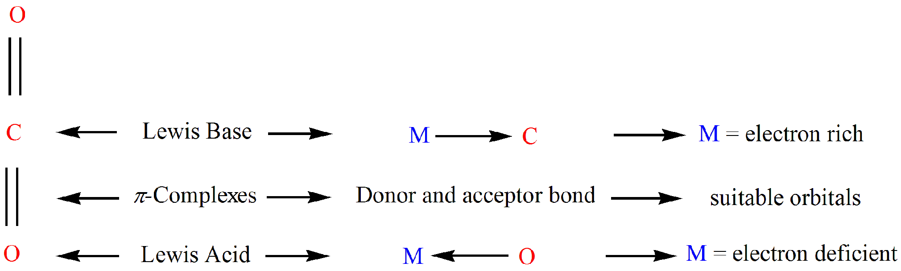
Reactive positions of the CO₂ molecule and the electronic characteristics of a transition metal center required for complexation (M represents a metal atom):
W. Ji, H. Hu, W. Zhang, H. Huang, X. He, X. Han, F. Zhao, Y. Liu, Z. Kang, Dalton Trans., 2013, 42, 10690.
M. A. Scibioh, B. Viswanathan, Proc. Indn. Natl. Acad. Sci., 2004, 70 A, 65.

Slide 12
The classification of coordination modes of CO₂ in metal complexes (M represents a metal atom):
M. A. Scibioh, B. Viswanathan, Proc. Indn. Natl. Acad. Sci., 2004, 70 A, 65.

Slide 13
Electrocatalyst
Synthesis route to trans-[Ru(dmb)₂(Cl)(EtOH)](PF₆):

Slide 14
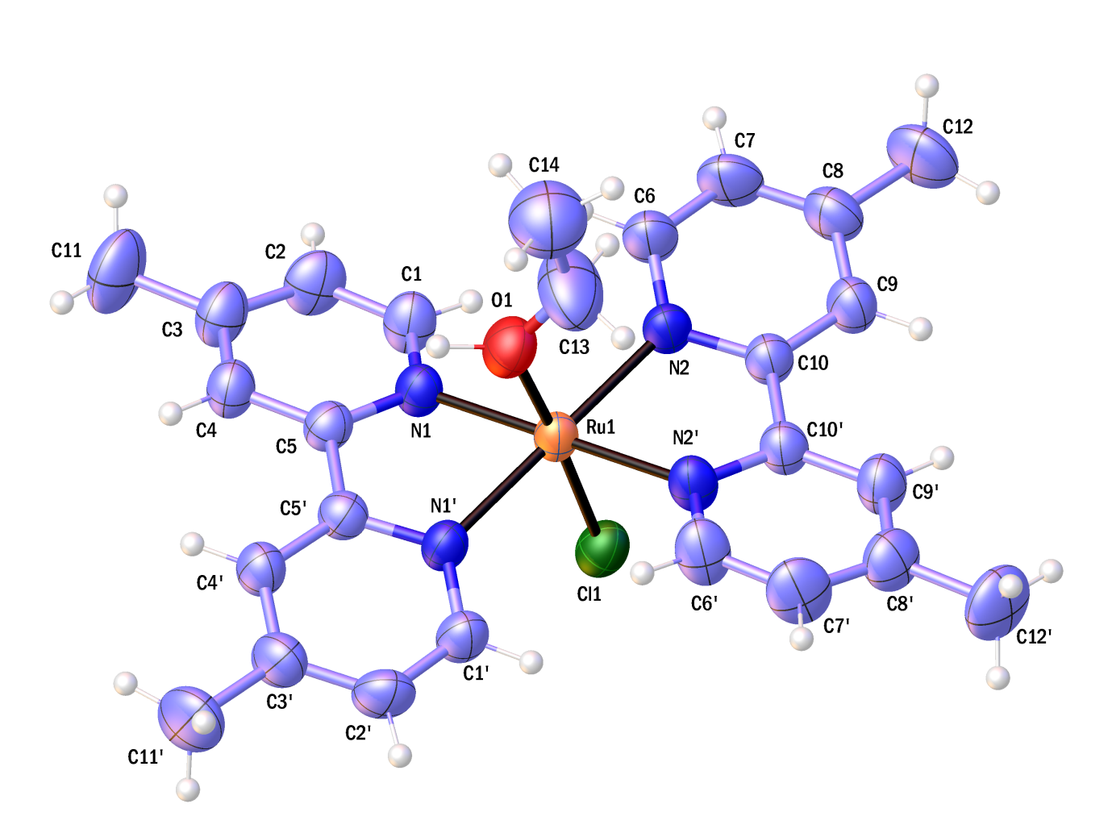
ORTEP plot of trans-[Ru(dmb)₂(Cl)(EtOH)]⁺:

Slide 15
Cyclic voltammogram of trans-[Ru(dmb)₂(Cl)(CH₃CN)](PF₆) in dry acetonitrile with 0.1 M TBAH as the supporting electrolyte at a scan rate of 0.1 V s^{–1}. (Left inset: Ru(III/II) couple at scan rates of 0.05–0.5 V s^{–1} and right inset: UV–vis spectroelectrochemical oxidation of trans-[Ru(dmb)₂(Cl)(CH₃CN)]⁺ in dry acetonitrile:

Slide 16
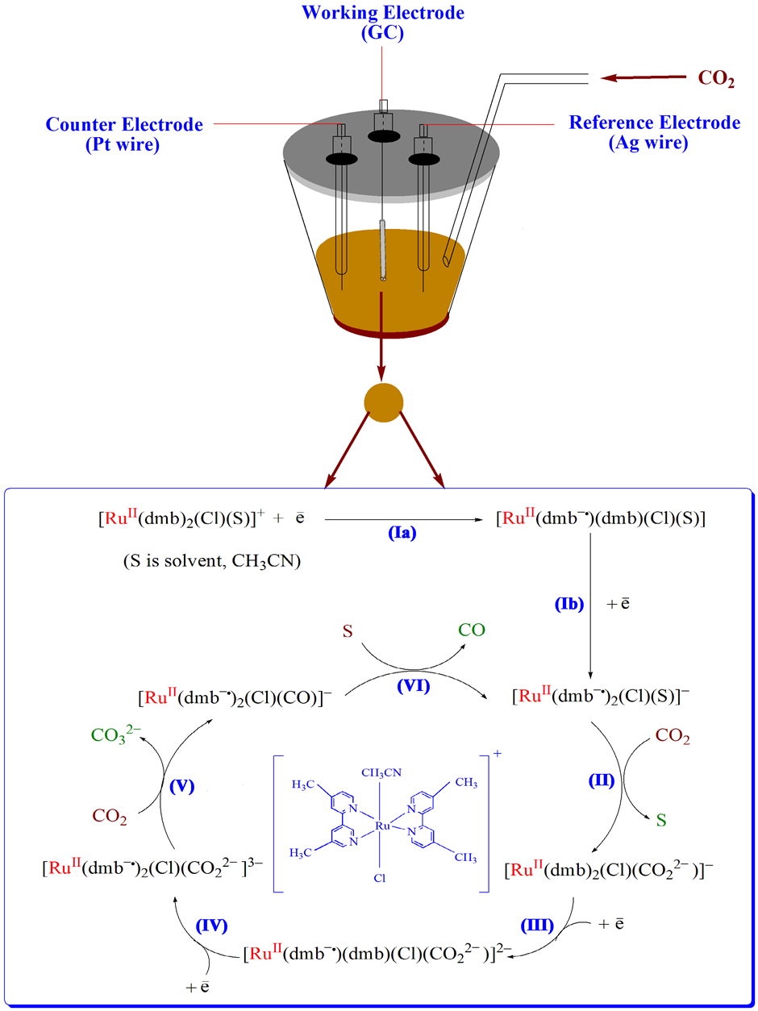
Proposed reaction mechanism for the electrocatalytic reduction of CO₂ by the Ru(II) complex in CH₃CN:

Slide 18
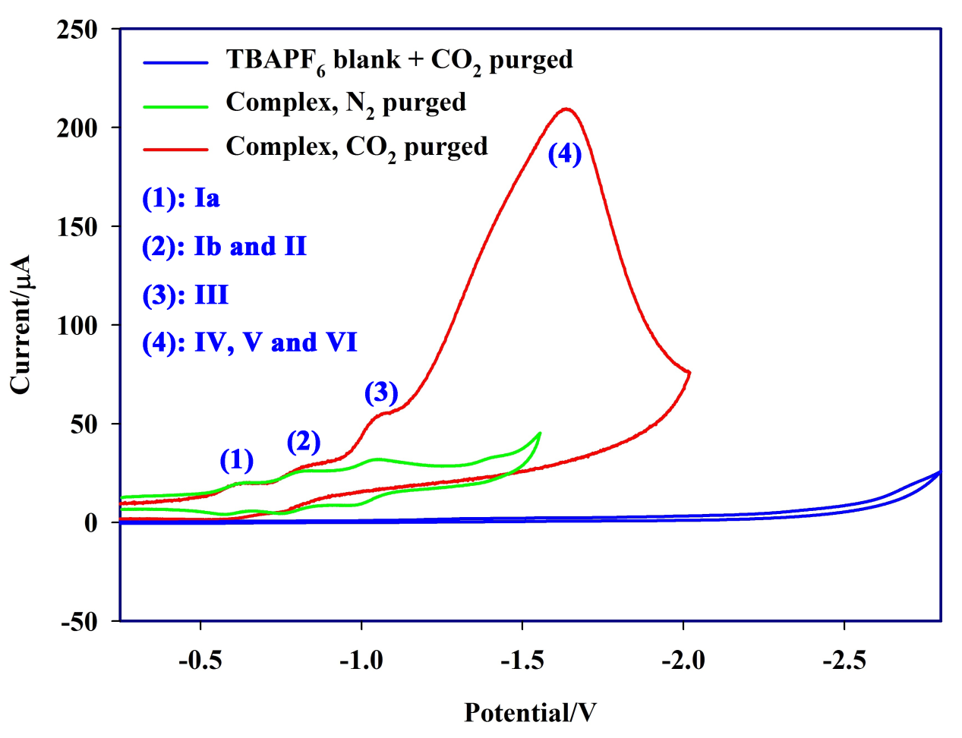
CVs of 2 mM of trans-[Ru(dmb)₂(Cl)(CH₃CN)](PF₆) in 0.1 M TBAH/CH₃CN under N₂ (green line) and CO₂ (red line) at room temperature. Working electrode: glassy carbon; scan rate, 0.1 V s^{–1}. The blank solution (without the complex) shows no reduction current (blue line):

Slide 19
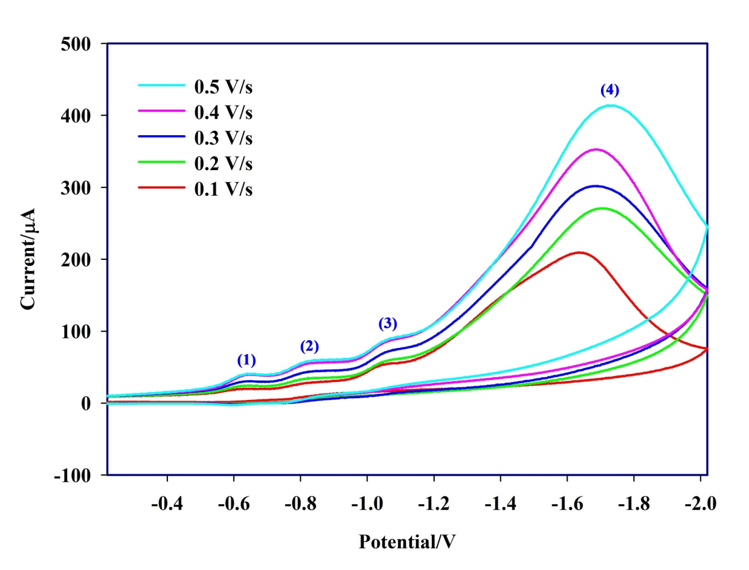
CVs of trans-[Ru(dmb)₂(Cl)(CH₃CN)](PF₆) (2 mM) in 0.1 M TBAH/CH₃CN under CO₂ at scan rates of 0.1–0.5 V s^{–1}:

Slide 20
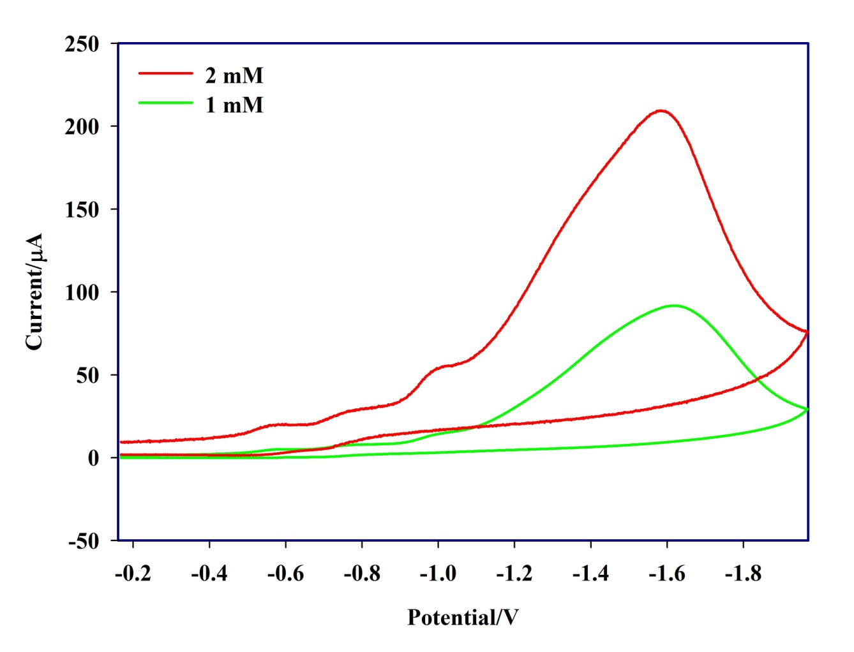
CVs of trans-[Ru(dmb)₂(Cl)(CH₃CN)](PF₆) in 0.1 M TBAH/CH₃CN under CO₂ in different concentrations at room temperature:

Slide 21
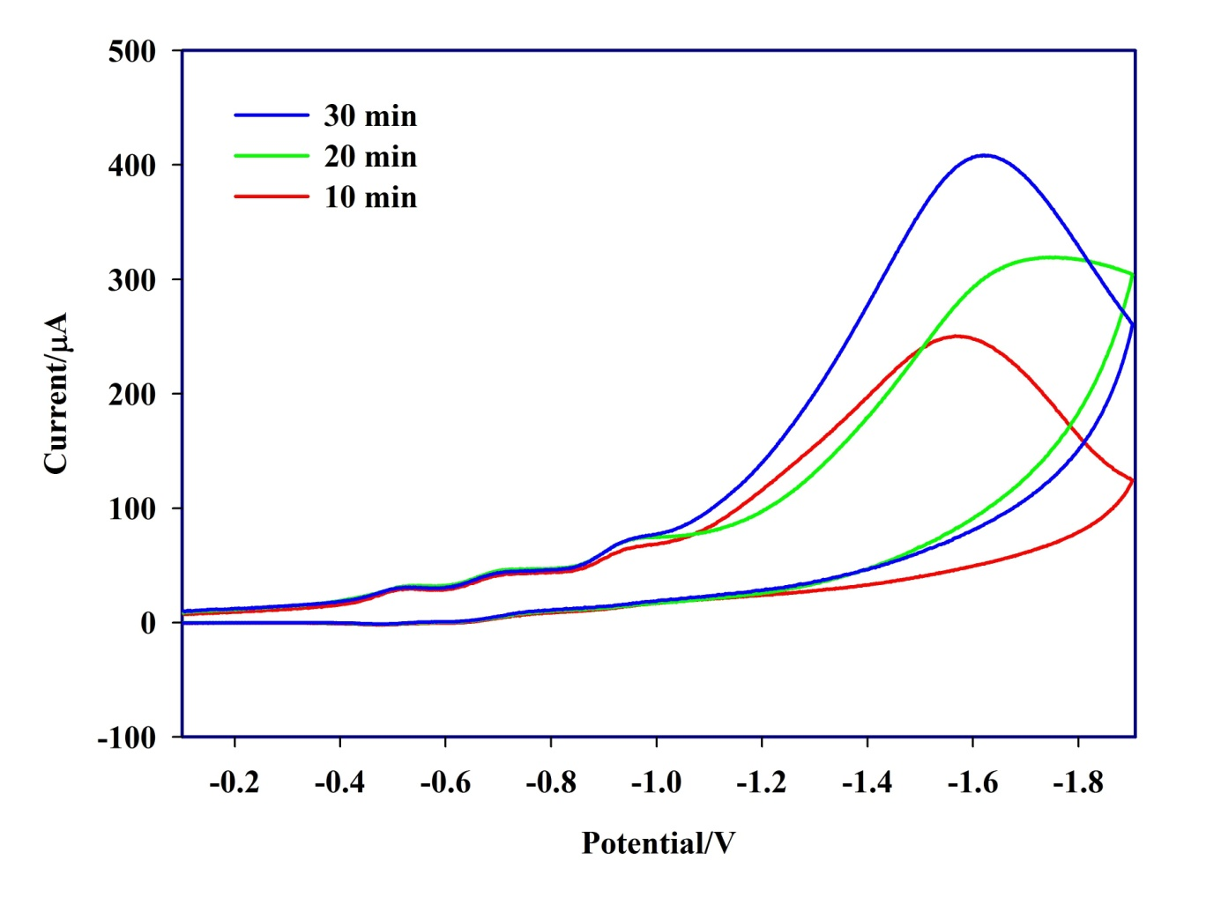
CVs of trans-[Ru(dmb)₂(Cl)(CH₃CN)](PF₆) (2 mM) in 0.1 M TBAH/CH₃CN under CO₂ after different purging times at room temperature:

Slide 22
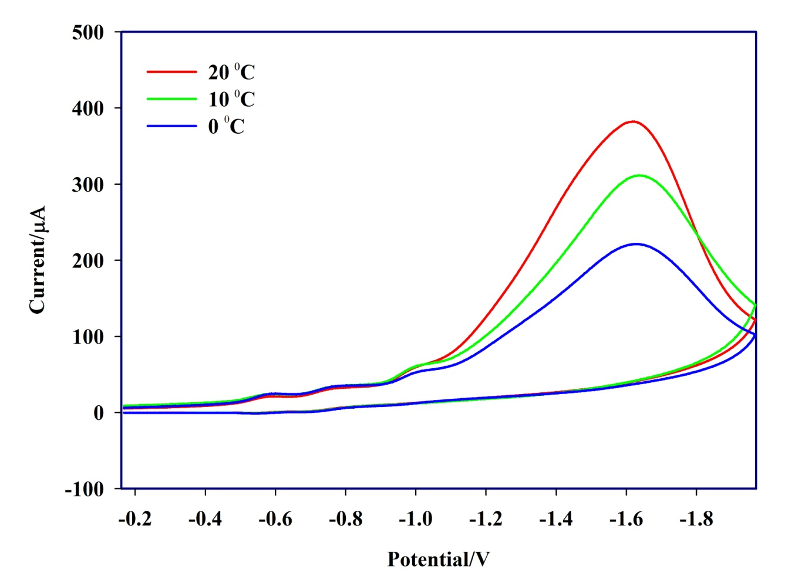
CVs of trans-[Ru(dmb)₂(Cl)(CH₃CN)](PF₆) (2 mM) in 0.1 M TBAH/CH₃CN under CO₂ at different temperatures:

Slide 23
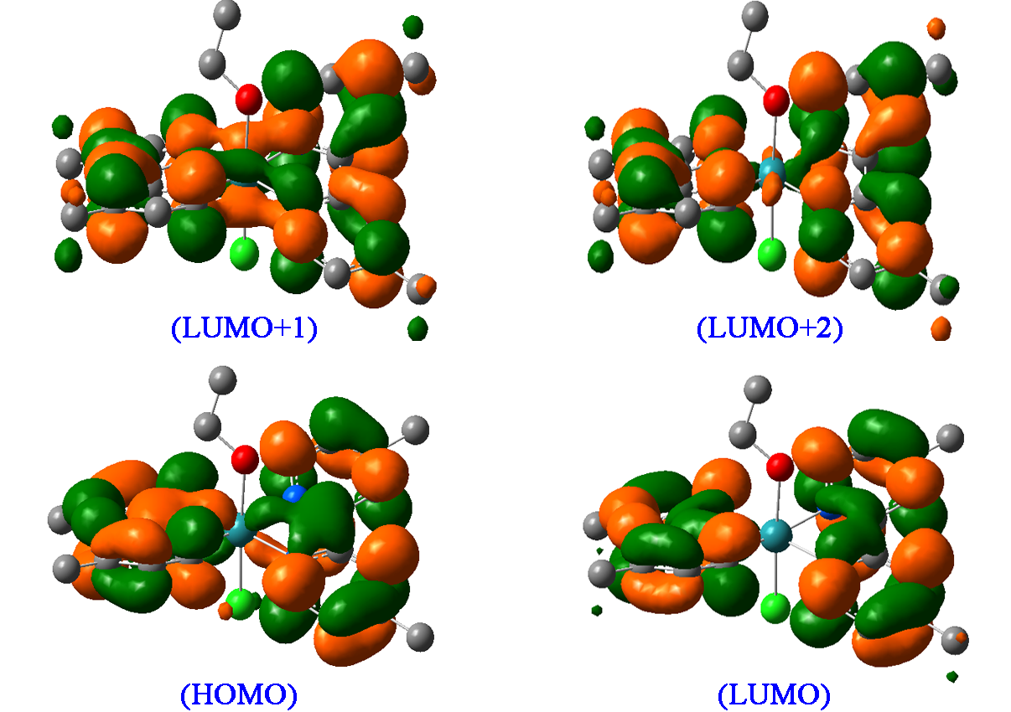
The HOMO, LUMO, LUMO + 1, and LUMO + 2 of trans-[Ru(dmb)₂(Cl)(EtOH)]⁺:

Slide 24
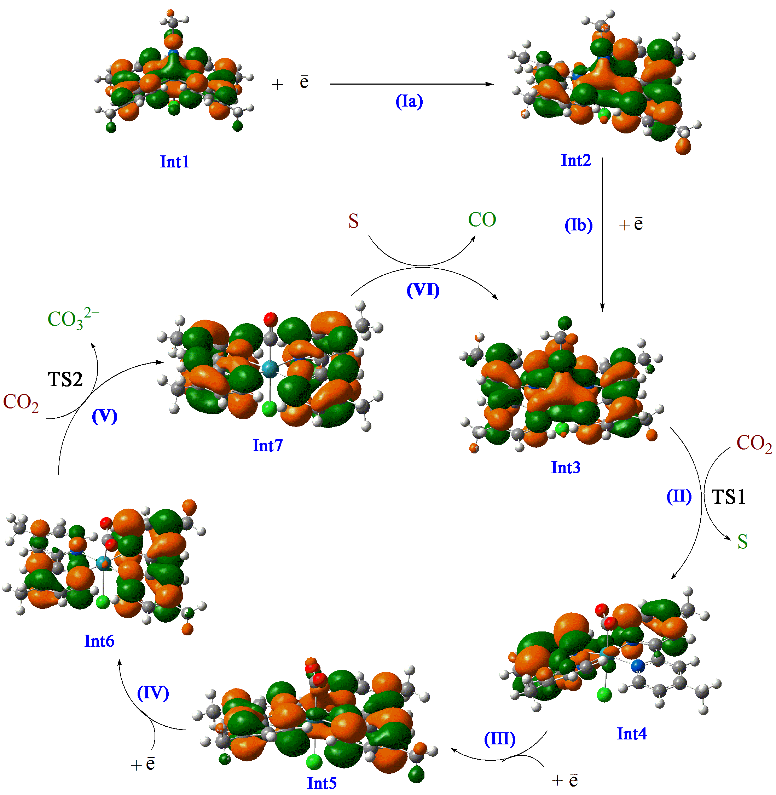
The schematic representation of HOMOs of the species in the proposed mechanism for the electrocatalytic reduction of CO₂ by the Ru(II) complex:

Slide 25
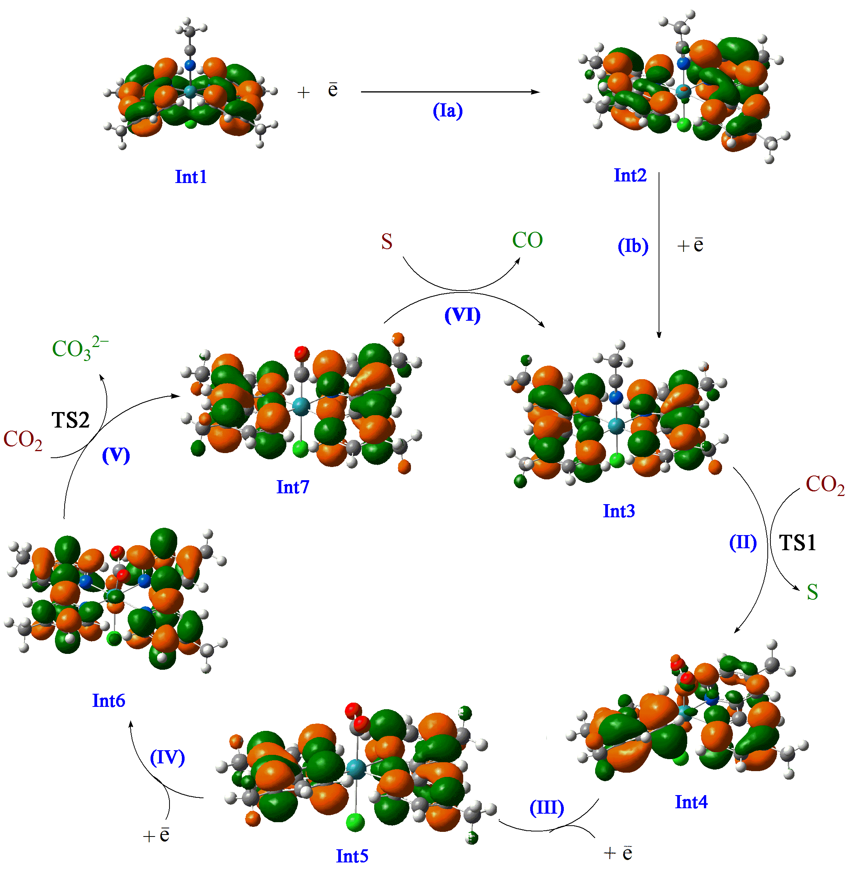
The schematic representation of LUMOs of the species in the proposed mechanism for electrocatalytic reduction of CO₂ by the Ru(II) complex:

Slide 26
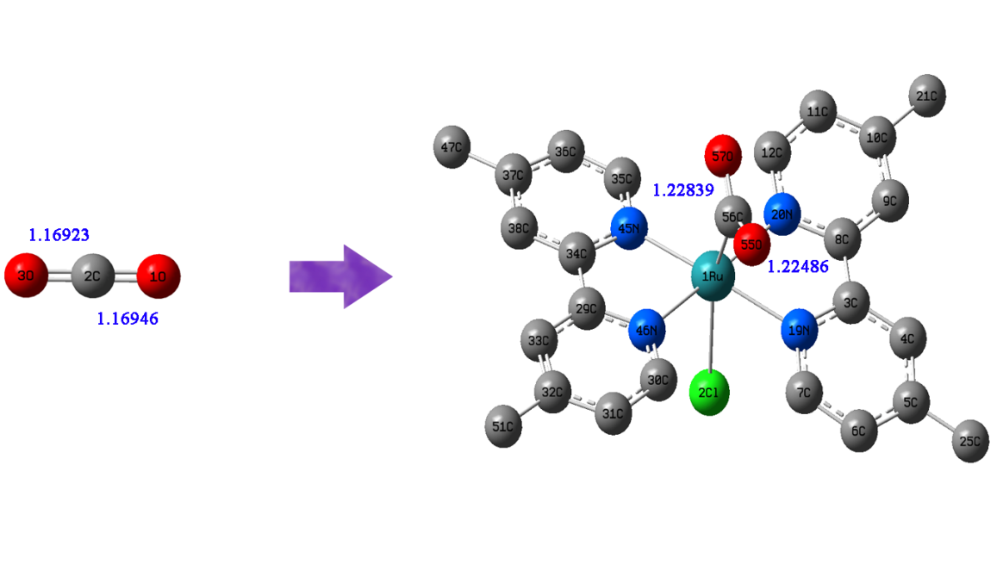
The optimized structures of free CO₂ and Int6 (trans-[Ru^{II}(dmb–•)₂(Cl)(CO₂^{2–})]^{3–} ) in the gas phase. The bond lengths are in angstroms:

Slide 27
The change of charge of the pyridyl moieties of the dmb ligands through one-electron reductions in steps I, III and IV:

Slide 28
Schematic representation of the selective vibrational modes in the transition states TS1 and TS2 in the proposed mechanism:

Slide 29
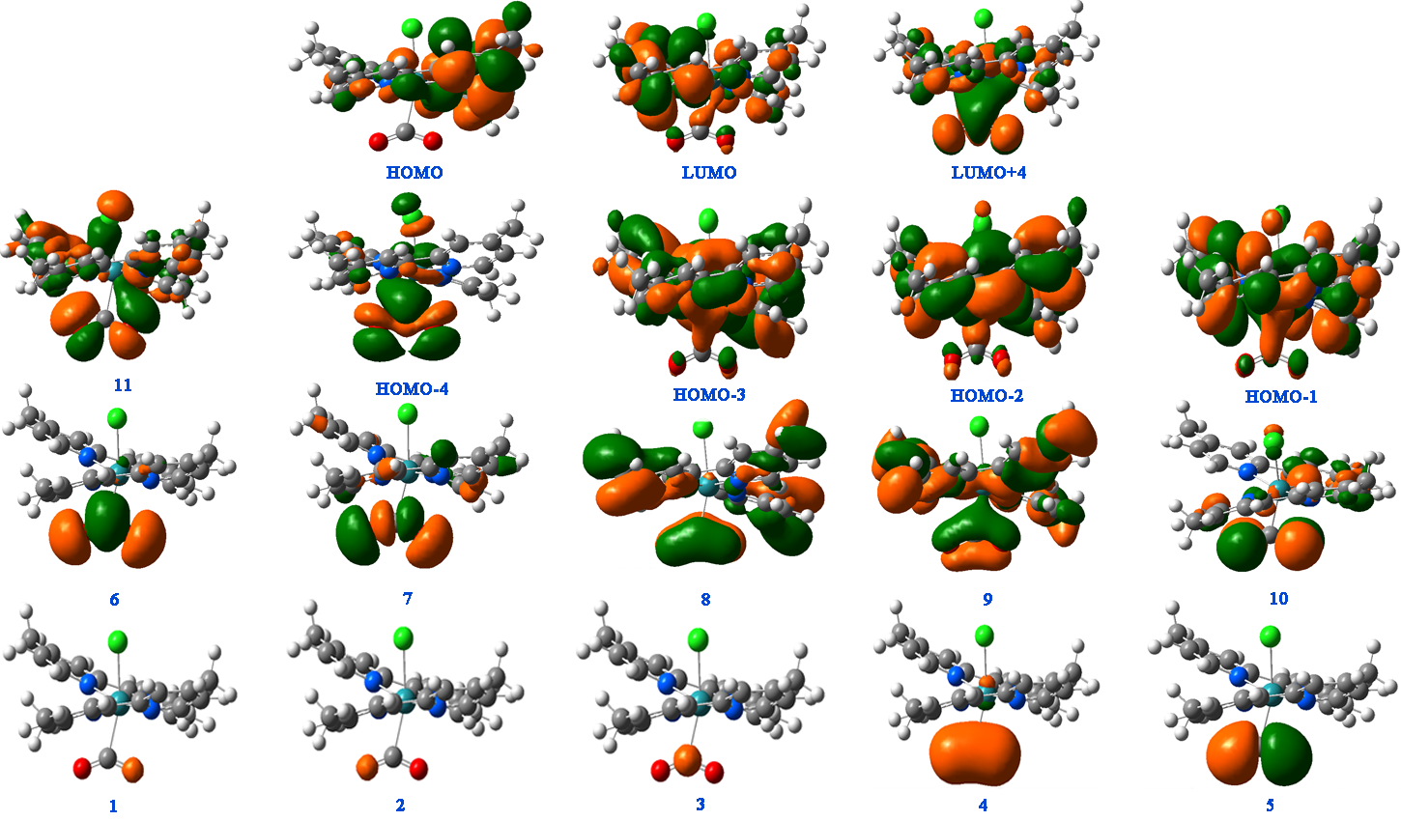
The calculated CO₂-character MOs in trans-[Ru(dmb)₂(Cl)(CO₂^{2–})]–. (The numbers 1–11 are given to show the sequence of the MO levels based on their energy):

Slide 30
ΔG°_{g} (gas phase Gibbs free energy change, kcal mol^{–1}), and ΔG°_{sol} (solution phase Gibbs free energy change, kcal mol^{–1}) of each step at the DFT/B3LYP level of theory:
Step | ΔG°_{g} | ΔG°_{sol}
Ia | –94.919 | –67.589
Ib | –19.966 | –50.566
II | +3.916 | –4.814
III | +39.406 | –46.224
IV | +107.434 | –51.476
V | –84.226 | –37.586
VI | +32.307 | +32.557

Slide 31
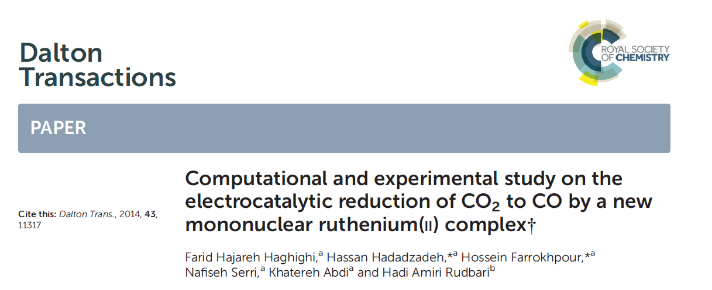

Slide 32
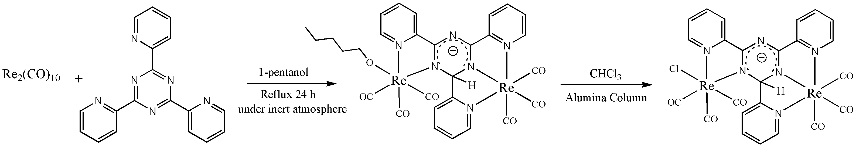
Photocatalyst
Synthesis route to [ReCl(CO)₃(μ-tptzH)Re(CO)₃]:

Slide 33
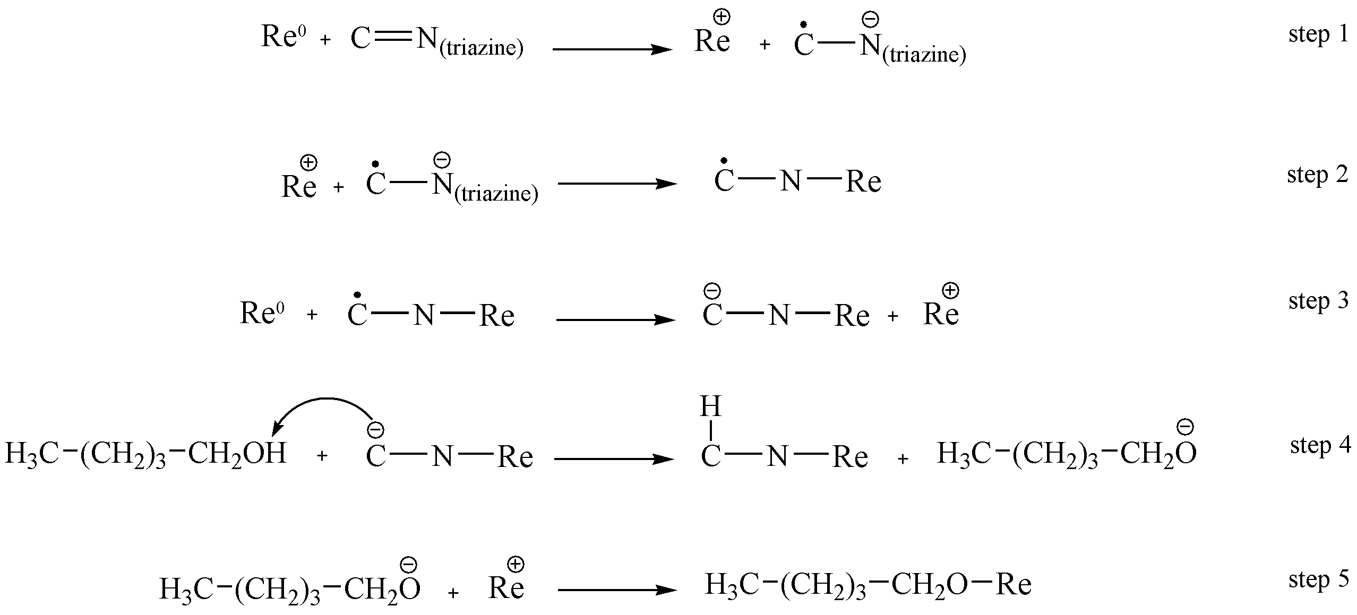
Saturation mechanism of the triazine ring in tptz:

Slide 34
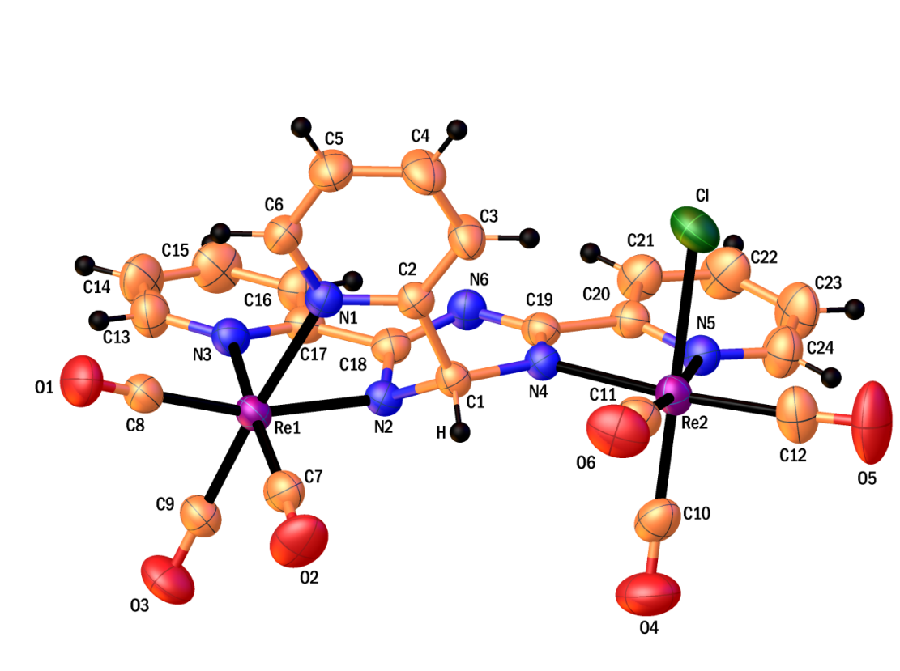
ORTEP plot of [ReCl(CO)₃(μ-tptzH)Re(CO)₃]:

Slide 35
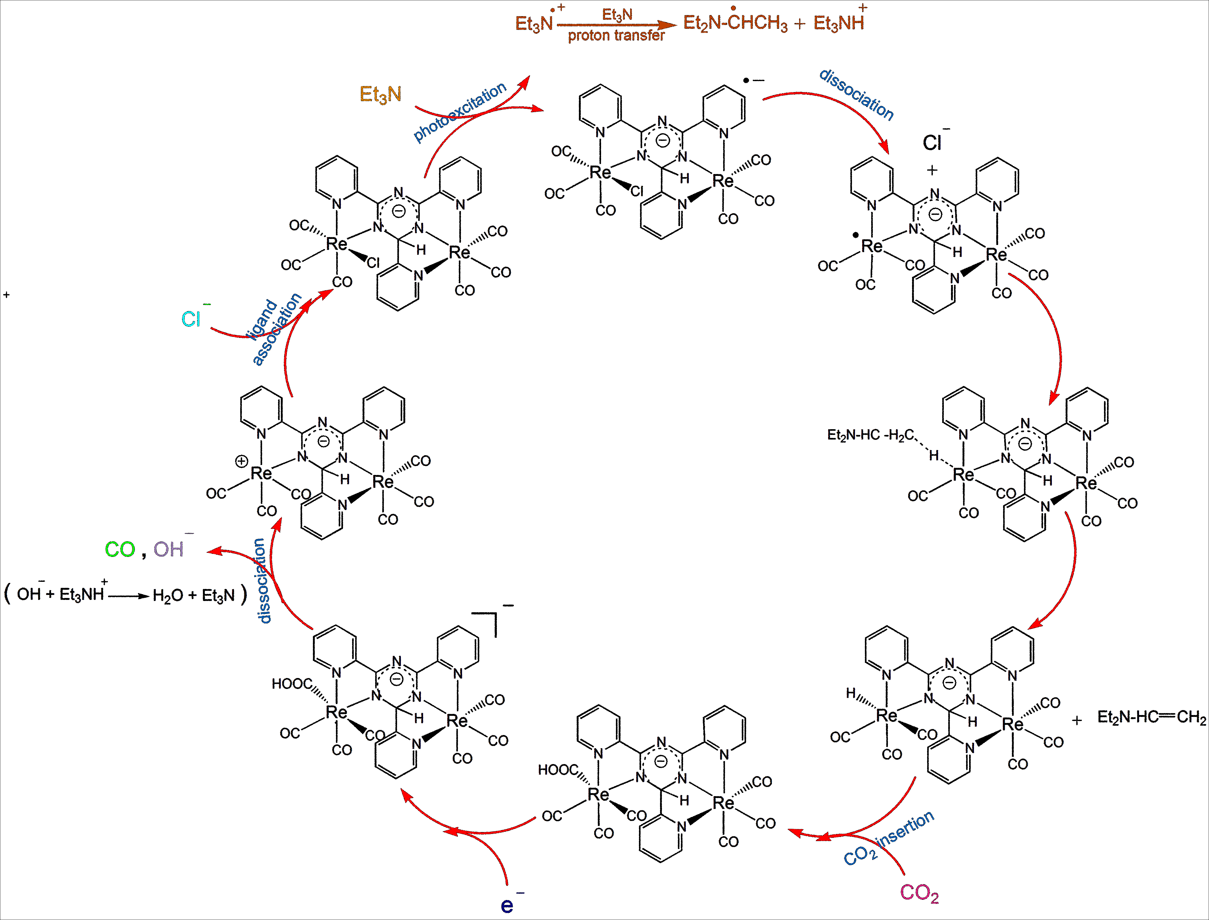
A proposed photocatalytic cycle for the reduction of CO₂ to CO.:

Slide 36
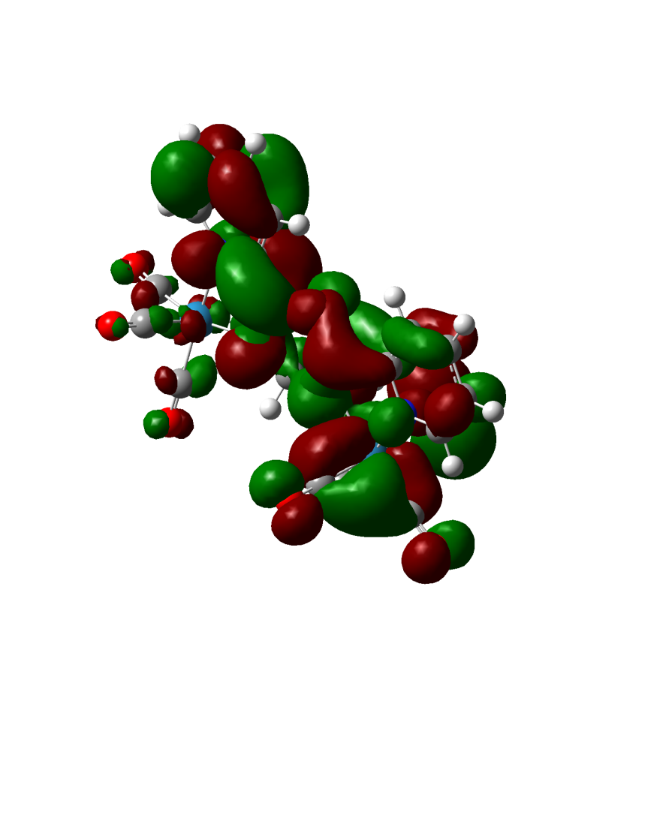
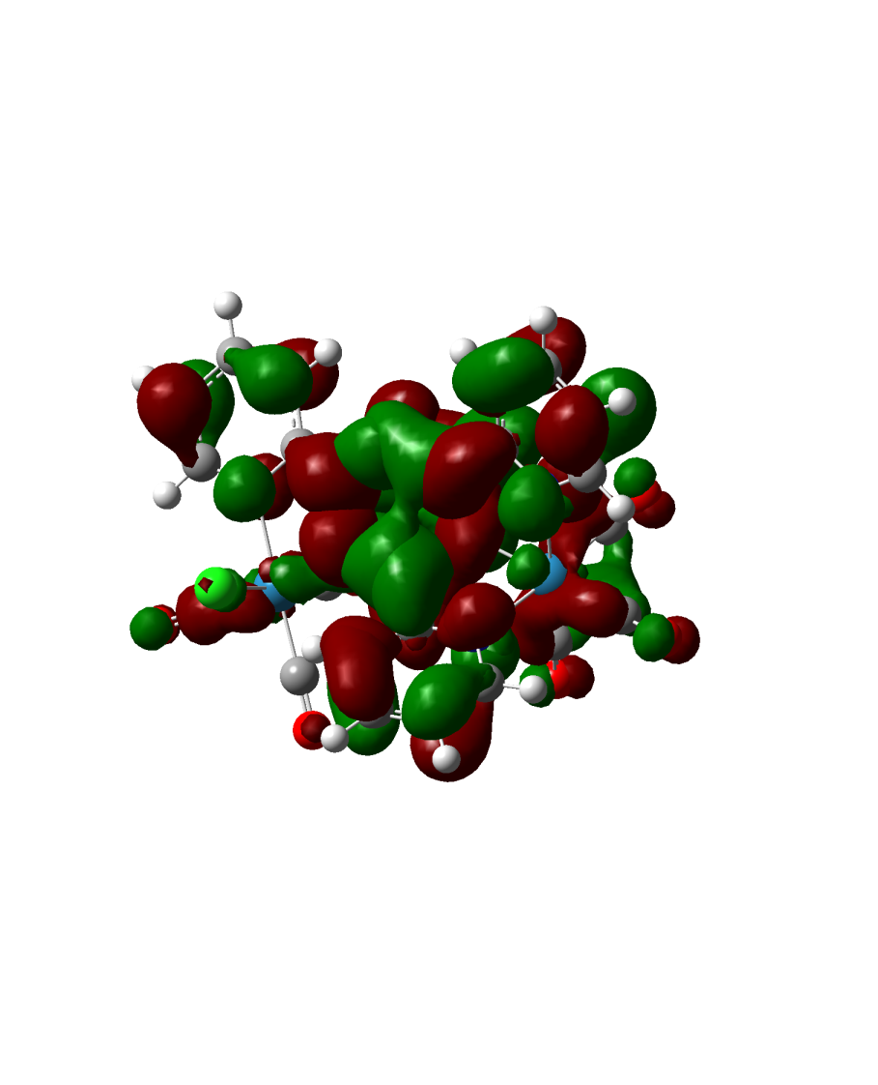
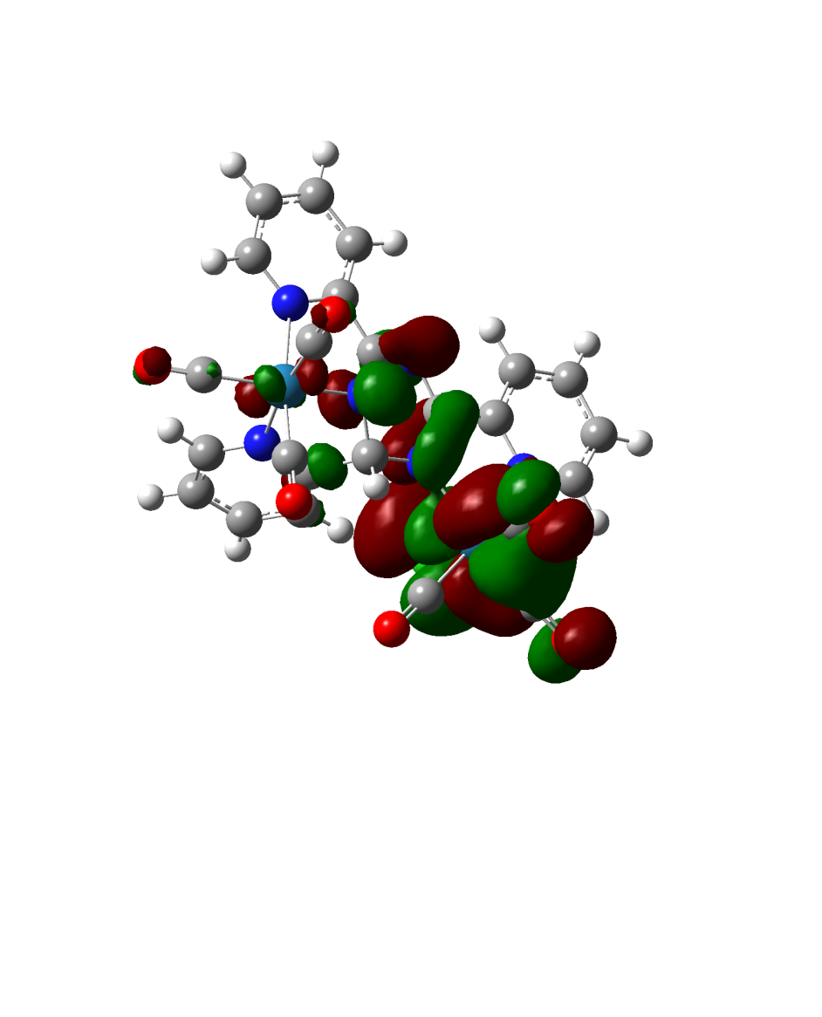
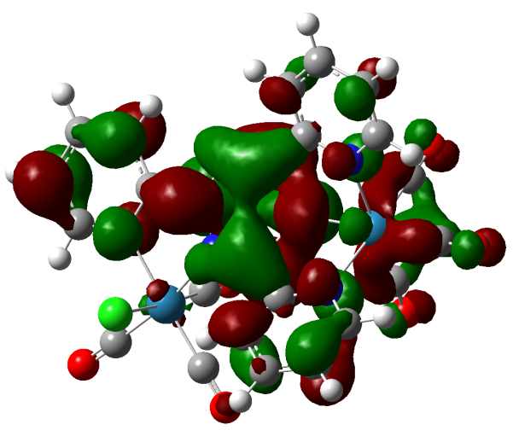
The HOMO and LUMOs of [ReCl(CO)₃(μ-tptzH)Re(CO)₃] (a) and
[ReCl(CO)₃(μ-tptz)Re(CO)₃] (b):
LUMO LUMO
(a)
(b)
HOMO HOMO

Slide 37
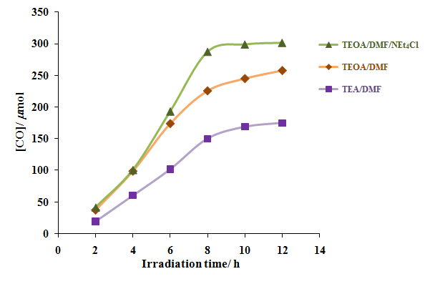
Irradiation-time (h) dependence of the CO formation (μmol) catalyzed by [ReCl(CO)₃(μ-tptzH)Re(CO)₃] under three different conditions: (green, ) TEOA/DMF/NEt₄Cl, (brown, ) TEOA/DMF, and (violet, ○) TEA/DMF:

Slide 38
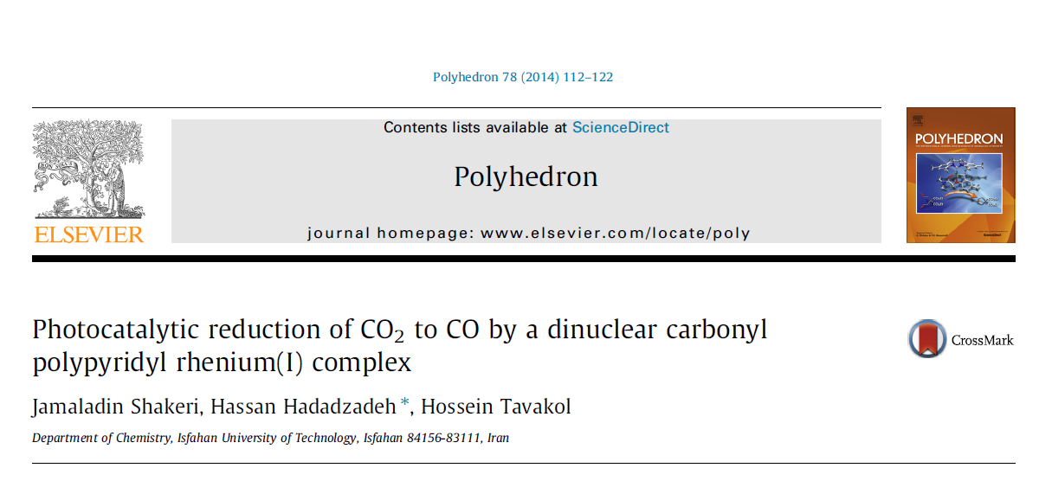

Slide 39
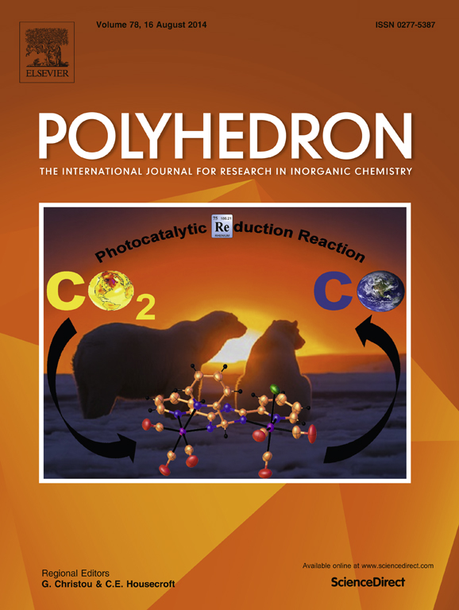

Slide 40
Ideal photochemical reduction
Light source
Combustion of fossil fuels
Combustion gases (such as CO₂)
Photocatalytic reactor
CO₂ CO
CO
CO₂
New combustion chamber
Energy

Slide 41
Ideal electrochemical reduction
Light source
Solar cell
Combustion gases (such as CO₂)
ē
Combustion of fossil fuels
Electrocatalytic reactor
CO₂ CO
CO
CO₂
New combustion chamber
Energy

Slide 42
Conclusion

Slide 43

Save me please

Slide 44
Thank You !
Special Thanks to: Dr. Hossein Farrokhpour, Dr. Hadi Amiri Rudbari
and my research group:
Dr. Marzieh Daryanavard (Postdoctoral Fellow)
Farid Hajareh Haghighi (PhD Student)
Jamaladin Shakeri (PhD Student)
Nafiseh Serri (MSc Student)
Khatereh Abdi (PhD Student)
www.Win2Farsi.com

Slide 45
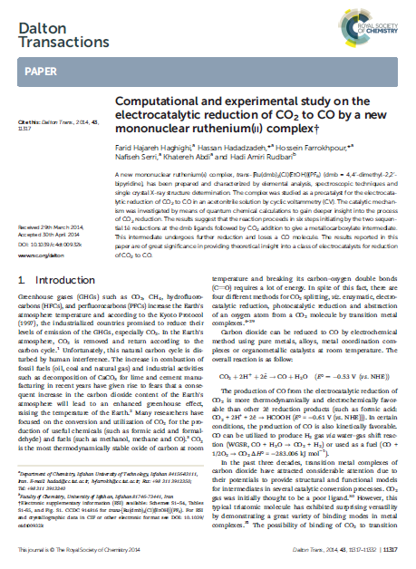

Slide 46
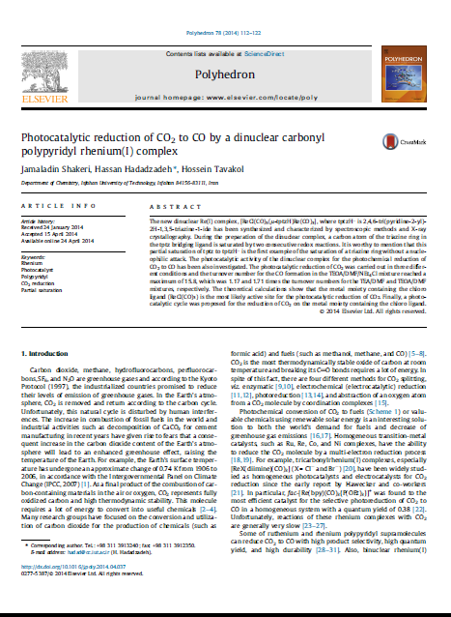

Slide 47
Electronic spectra of the Ru(II) complex; (a) 6.2 × 10^{–6} M (b) 1.43 × 10^{–4} M in acetonitrile at room temperature:

Slide 48
Variation of i_{p.c} with v^{1/2} for wave (4) in Fig. 5:

Slide 49
Thermodynamic cycle for a typical reaction. In the proposed catalytic cycle, n can be 0 (steps II, V and VI) or 1 (steps I, III and IV). It should be mentioned that in steps II, V and VI, there are more than one reactant (and also one product) but the overall pattern of eqns does not change:

Slide 50
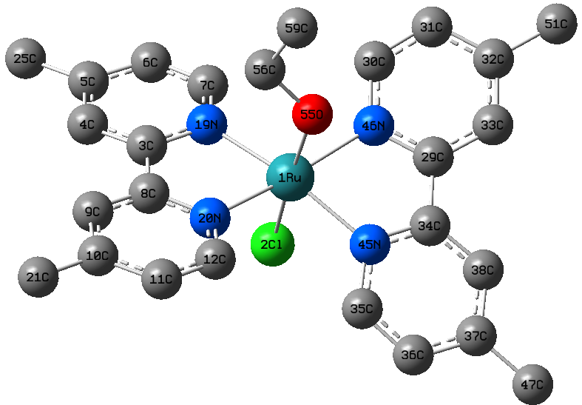
The optimized structure of trans-[Ru(dmb)₂(Cl)(EtOH)]⁺ in the gas phase (hydrogen atoms are omitted for clarity):

Slide 51
The optimized structures of Int1–Int7 in the gas phase (hydrogen atoms are omitted for clarity):

Slide 52
The optimized structure of the partially saturated ([ReCl(CO)₃(μ-tptzH)Re(CO)₃]) (a) and the unsaturated ([ReCl(CO)₃(μ-tptz)Re(CO)₃]) (b) complexes in the gas phase:
(a)
(b)

Slide 55

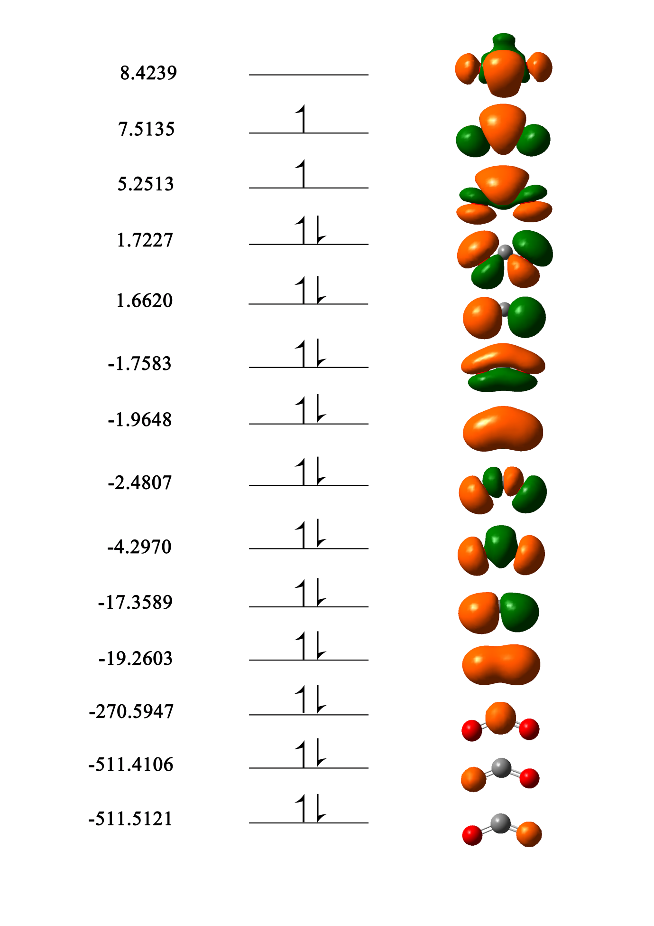
The HOMO and LUMOs of [ReCl(CO)₃(μ-tptzH)Re(CO)₃] (a) and
[ReCl(CO)₃(μ-tptz)Re(CO)₃] (b):
(a)
(b)

